Slide 1
Introduction to SQL Server Reporting Services-2008
Nand Kishor Kumar
September 2017
Xoriant

Slide 2
Topics
SSRS – a Reporting tool
Creating sample SSRS Report
Data Sources
Datasets
Report Parameters
Reports Layout
Table Reports
Matrix Reports
Lists

Slide 3
Topics Continued..
Chart and Graphs
Sub Reports
Export Options
Variables
RDL
Reports Deployment
Reports Delivery

Slide 4
SSRS
SQL Server Reporting Services is a Microsoft Reporting Tool.
Provides ready to use tools and services to create, deploy and manage reports.
Provides programming features to extend and customize report functionality.
Works within Microsoft Visual Studio environment.
Fully integrated with SQL server tools and components.
Support real time as well as batch reports.

Slide 5
Creating Sample SSRS Report
SSRS is available in Visual Studio BIDS (Business Intelligence Development Studio)
BIDS is included with SQL Server product. When you are running the SQL Server installer, you need to click the Business Intelligence Development Studio checkbox in order to install BIDS. After successfully completing the installation, you are ready to launch BIDS from the Microsoft SQL Server 2008.
Report Wizard:
  New Project -> Report Server Project Wizard
  Add Item -> Report Wizard
demo..

Slide 6
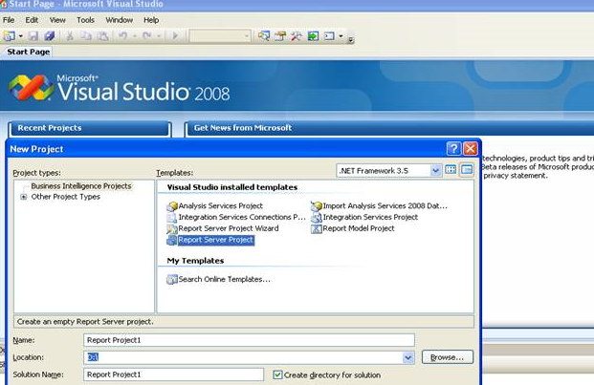
Creating Sample SSRS Report
Report Wizard:
  New Project -> Report Server Project Wizard
  Add Item -> Report Wizard
demo..

Slide 7
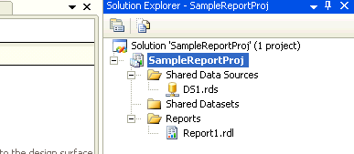
Creating Sample SSRS Report
Steps for creating a report:
  Define Data Source
  Design Query & Report Logic (Dataset)
  Choose Report Type (Table/Matrix)
  Define Report Layout (XML based RDL file)
  Choose Report Formatting
  Deploy Report

Slide 8
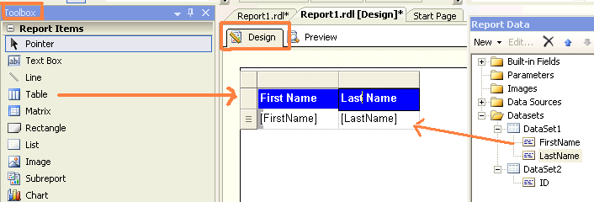
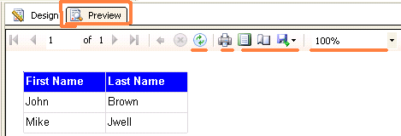
Sample SSRS Report: Example
Drag Report Items from Toolbar for report design and drag data fields from dataset..
Preview the report by clicking Preview tab.

Slide 9
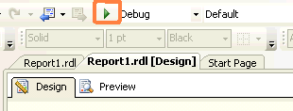
Sample SSRS Report: Example
Options available on Preview tab are:
  Page navigator
  Refresh Report
  Print Report /Print Layout
  Page Setup
  Export
  Zoom
Report can be run by clicking “run” button.
Need to set startup project and startup report before running the report.

Slide 10
Data Sources
Connection information for reporting data.
Data Sources supported:
  Any OLEDB/ ODBC – compliant data source
  Relational:
    SQL Server
    Oracle
    MS Access
  OLAP: SSAS
  XML, Excel, CSV, TSV etc.

Slide 11
Datasets
Actual logic of report is written in dataset.
  One report can have multiple datasets.
  Dataset is mapped to a data source.
  Output fields of dataset are used in report design.
Dataset Properties:
  Query (Text or Stored Procedure)
  Fields
  Data Options
  Parameters
  Filters

Slide 12
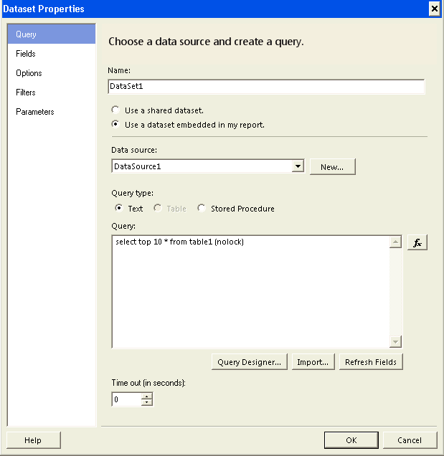
Datasets
demo..

Slide 13
Dataset Properties
Query (Text or Stored Procedure)
  Query can be written in Text or can be used as Stored procedure.
  Query designer help in creating the query.
  Query can be imported from external file location.
  Timeout can be set on the same tab.
Fields
  Query output is default available in Fields option.
  Calculated field can be added by applying formulas.
  Formulas can be used using different string, mathematical functions.

Slide 14
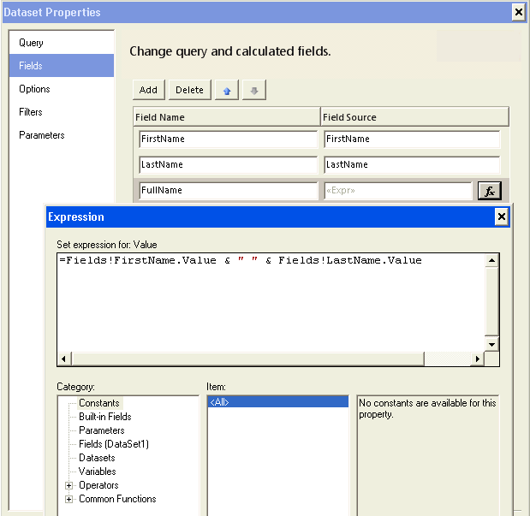
Dataset Properties
Fields Continued..
demo..

Slide 15
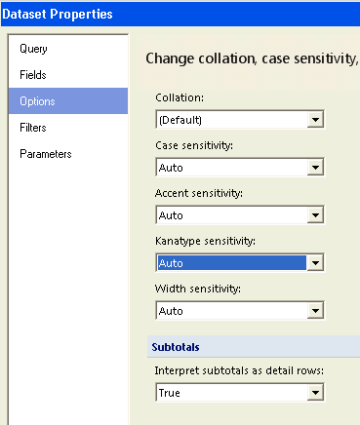
Dataset Properties
Options
  Collation, case sensitivity and other options can be set.

Slide 16
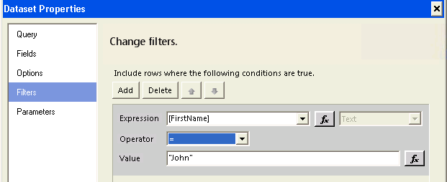
Dataset Properties
Filters:
  It allows to apply filter in the report at runtime on dataset values.
Parameters:
  Parameters allow to filter the data by taking input from user on the report.

Slide 17
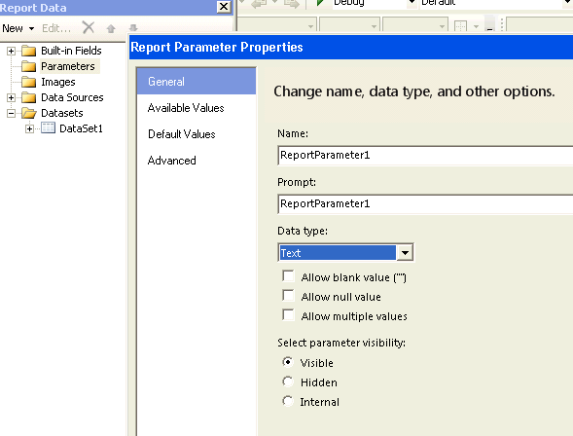
Report Parameters
Parameters can be added with Single/multi values.
Name (used internally), Prompt (which is what users will see)
Dataset query has to use the parameter to filter the data with below format.
Select name from table
where Column= @ReportParameter1
demo..

Slide 18
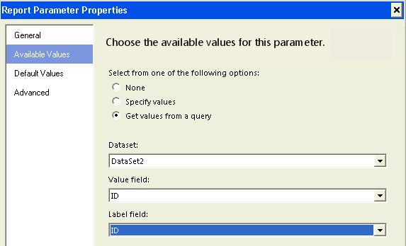
Multi valued Parameters
In Parameter Properties -> Available Values, by selecting “Get values from a query” will make the parameters appear as a dropdown box.
Dataset query has to use the parameter to filter the data with below format.
Select name from table
where Column= @ReportParameter2
demo..

Slide 19
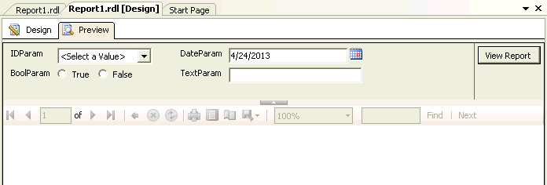
Other Parameters
If data type is selected as DateTime, it creates date time parameter on the report.
If data type is selected as Boolean, it creates radio button parameter with true/false values. Radio button parameter cannot be created with custom list of values.
Sample Parameters:

Slide 20
Reports Layout
Table reports
Matrix reports
List
Chart/Graph
Drill down reports
Complex reports
Dashboards

Slide 21
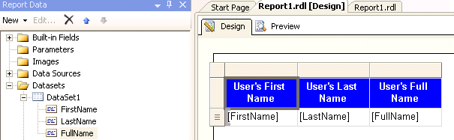
Table Reports
Table layout has fixed number of columns.
Report can have page header, page footer, report header and report footer.
Steps:
  Drag “Table” from Toolbox items.
  Drag fields from dataset in data section.
  Set the Header values if required.
  Preview the report.

Slide 22
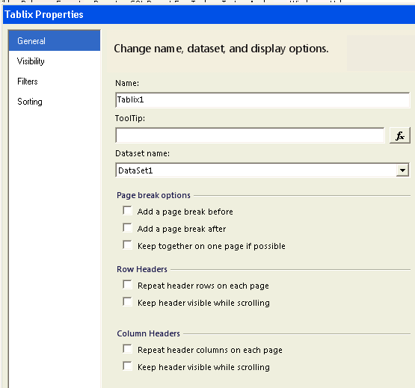
Table Reports: Other Properties
Page break options
Row Headers
Column headers
Set Fonts and Colors
Set borders
Apply filters
Sorting
Add calculated fields
demo..

Slide 23
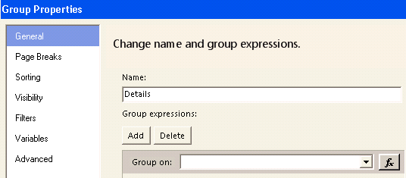
Table Reports: Grouping
To group data in report.
To add group level totals in report.
To add grand total in report
Different properties are:
  Page Breaks
  Sorting
  Visibility
  Filters
  Variables
  Advanced
Page header/footer and report header footer can use aggregations.
demo..

Slide 24
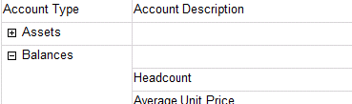
Table Reports: Expand/Collapse
Grouped rows can be Collapsed and Expanded in Layout.
Steps:
  Apply grouping for the rows
  Set default visible property of Group to “Hide”
  Take a hidden parameter with Specified values as “Expand” and “Collapse”
  Use expression for Group Properties -> Visibility: “=iif(Parameters!ParamExpandOrCollapse.Value = "Collapse", True, False)”
SSRS 2008 R2 version have this option directly in
  Group Properties -> Visibility -> “Display can be toggled by this report item” check box.
demo..
*Source :SQLChick.

Slide 25
Matrix Reports
Matrix reports are used to show data in form of Pivot table or Crosstab reports.
Columns in the report are not fixed. It will vary as per the data.
Steps:
  Drag Matrix layout from toolbar.
  It has Rows, Columns and Data sections.
  Drag fields from dataset to rows, columns and data sections as per the report format.
  Data section will always use some aggregation functions.
  Add Groupings, headers and footers as required.
demo..

Slide 26
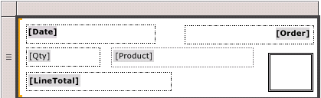
Lists
A format can be specified in the List layout.
It repeats with each group or row in the report dataset.
Sample List:
*Source :msdn.

Slide 27
Chart and Graphs
Report can be prepared in Graphical format.
Drag Chart from Toolbar and set the chart properties from dataset.
Different types of charts:
  Column
  Bar
  Area
  Line
  Pie Chart
  Doughnut
  Scatter
  Bubble
  Stock
  Spatial (from R2 version)
  Sparklines (from R2 version)
  Mapping (from R2 version)

Slide 28
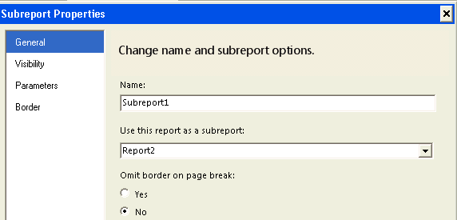
Sub Reports
Sub Reports can be created when main report need to have multiple related reports.
First a report has to be created separately (that will act as a sub report) and that can be linked to main report as sub report.
Parameter can be passed from main report to sub report.
On main report, sub report option can be dragged from Toolbar.
demo..

Slide 29
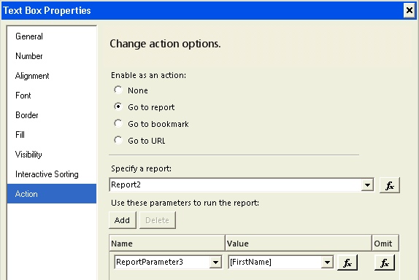
Sub Reports (linked with Hyperlink)
Reports can be linked with field values by creating them as hyperlink.
On click of a value in a row, the sub report opens with the parameter specified on the click.
On Text box properties, Action -> Go to report set the sub report on click of specific cell value.
demo..

Slide 30
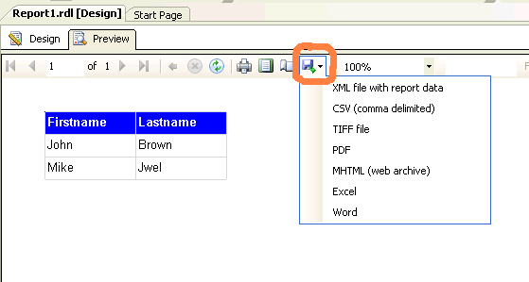
Export Option
Reports can be viewed in Browser.
Export options available are:
  XML
  CSV
  TIFF
  PDF
  MHTML
  Excel
  Word

Slide 31
Variables
Can be defined at Report level or at group level.
Can only be set/initialized once and have read only semantics.
Can be used for below scenarios:
  Caching values or for expensive calculations.
  Time dependent calculations like currency conversion.

Slide 32
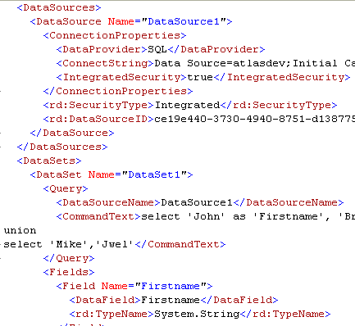
RDL: Report Definition Language
SSRS supports RDL.
RDL is report information in XML format.
XML can be viewed by right click on .rdl file and view code.
Sample RDL formats:

Slide 33
Reports Deployment
Single report/ data source can be deployed or entire proejct can be deployed.
Open project properties. It opens Deployment options.
Set below options in deployment and click Ok button.
  OverwriteDataSources
  TargetDataSourceFolder
  TargetReportFolder
  TargetServerURL
Now right click on project and click “Deploy”.
It deploys the report to target reporting server. The report can be accessed by accessing Target URL.
.RDL File can be uploaded through website.
Can overwrite a current report to remain all settings unchanged.
demo..

Slide 34
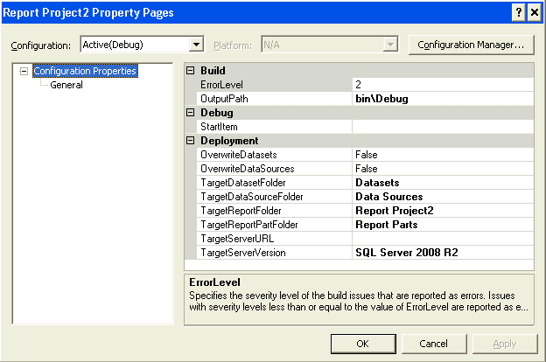
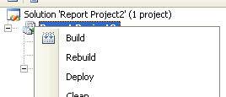
Reports Deployment
demo..

Slide 35
Reports Delivery
Email Delivery
  Email delivery Delivers a rendered report to an email inbox.
  Allows setting delivery option that control an output format and whether the report is delivered as a link or as an attachment.
  Uses SMTP server defined in Reporting Services Configuration tool
File share delivery:
  Delivers a rendered report to a shared folder.
  Allows setting delivery options that control a destination folder path, an output format and whether the report overrides an older verison or is added as a new version.

Slide 36
  Thanks!

